Slide 1


UNIVERSITY OF NORTH TEXAS
Department of Computer Science and Engineering
Vamshi Krishna Bukka (SCRUM MASTER)
DivyaMounica Mogalturthi
Radhakrishna Revanth Boddupalli
Yaragarla Pravallika
Bharath Chowdary Avulapati
Sivabhavana Nelluri
Vikram Reddy Allam
Vamsi Krishna Javvaji
CSCE 5430 Software Engineering Project 2023
Under the guidance of Prof. Mohsen Amini
Group-7 the Bright soul

Slide 2

introduction
The “Bright soul” Project is a valuable resource for people in mental pressure. It provides information,resources and support people to improve their mental health.

Slide 3
Moore’s Law
"For those who are mentally distressed, for the elderly, for teenagers Who are squandering their lives, 'THE BRIGHT SOUL' project is a website operating on the web That offers mental tranquility, enhances positivity, and alleviates stress. Unlike other web blogs, Our website delivers mental peace and positivity within a single platform, catering specifically to individuals under mental pressure."

Slide 4

USER stories
1.As a user, feeling stressed and overwhelmed, I want to learn about and practice stress management techniques, so that I can cope with my stress and improve my mental well-being.
2. As a user who is interested in learning more about mental health, I want to find accurate and informative content that is easy to understand, so that I can learn about different mental health conditions and how to support myself and others.
3. As a user, I want to be able to create and manage my account, so that I can access the resources and support I need.
4. As a user with anxiety, I want to find a list of relaxation techniques so that I can use to calm down when I'm feeling anxious.

Slide 5
USER stories
5. As a user, I want to be able to receive notifications about upcoming events, so that I don't miss out on any opportunities to learn and connect.
6. As a user, I want to order books on mental health, so that I can learn more about mental health and self-help strategies at my own pace.
7. As a project administrator, I want to be able to manage website, so that I can provide users with informative and supportive opportunities to learn and connect.
8. As a user who wants to share my mental health story, I want to find a platform so that I can write a blog post or create a video about my experience.
9. As a user who is struggling to talk about my mental health, I want to find a safe and supportive space to share my story and connect with others who understand what I'm going through, so that I can feel less alone and more supported

Slide 6

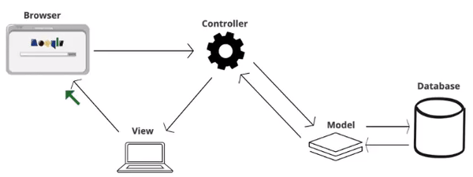
Architecture:
MVC architecture Model
View
Controller

Slide 7

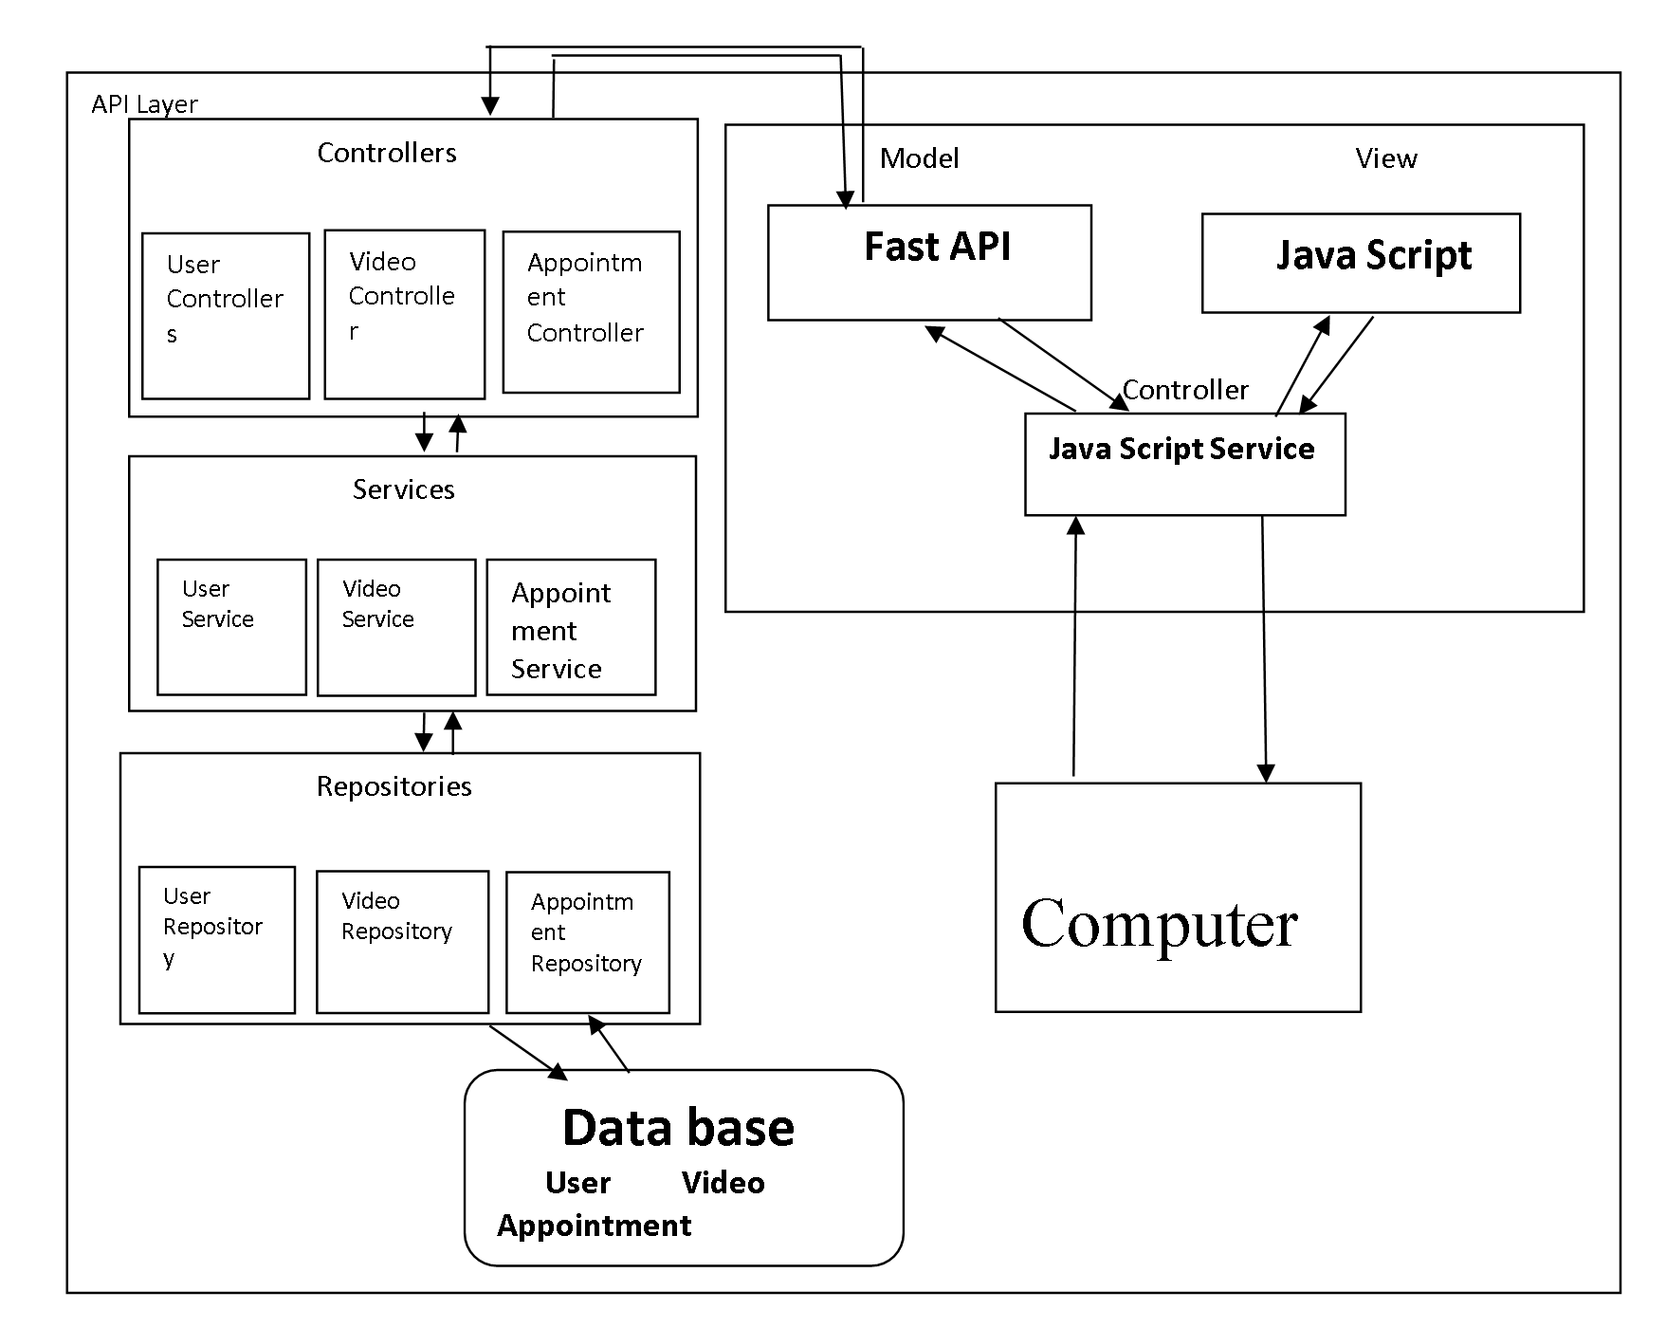
Bright soul architecture

Slide 8
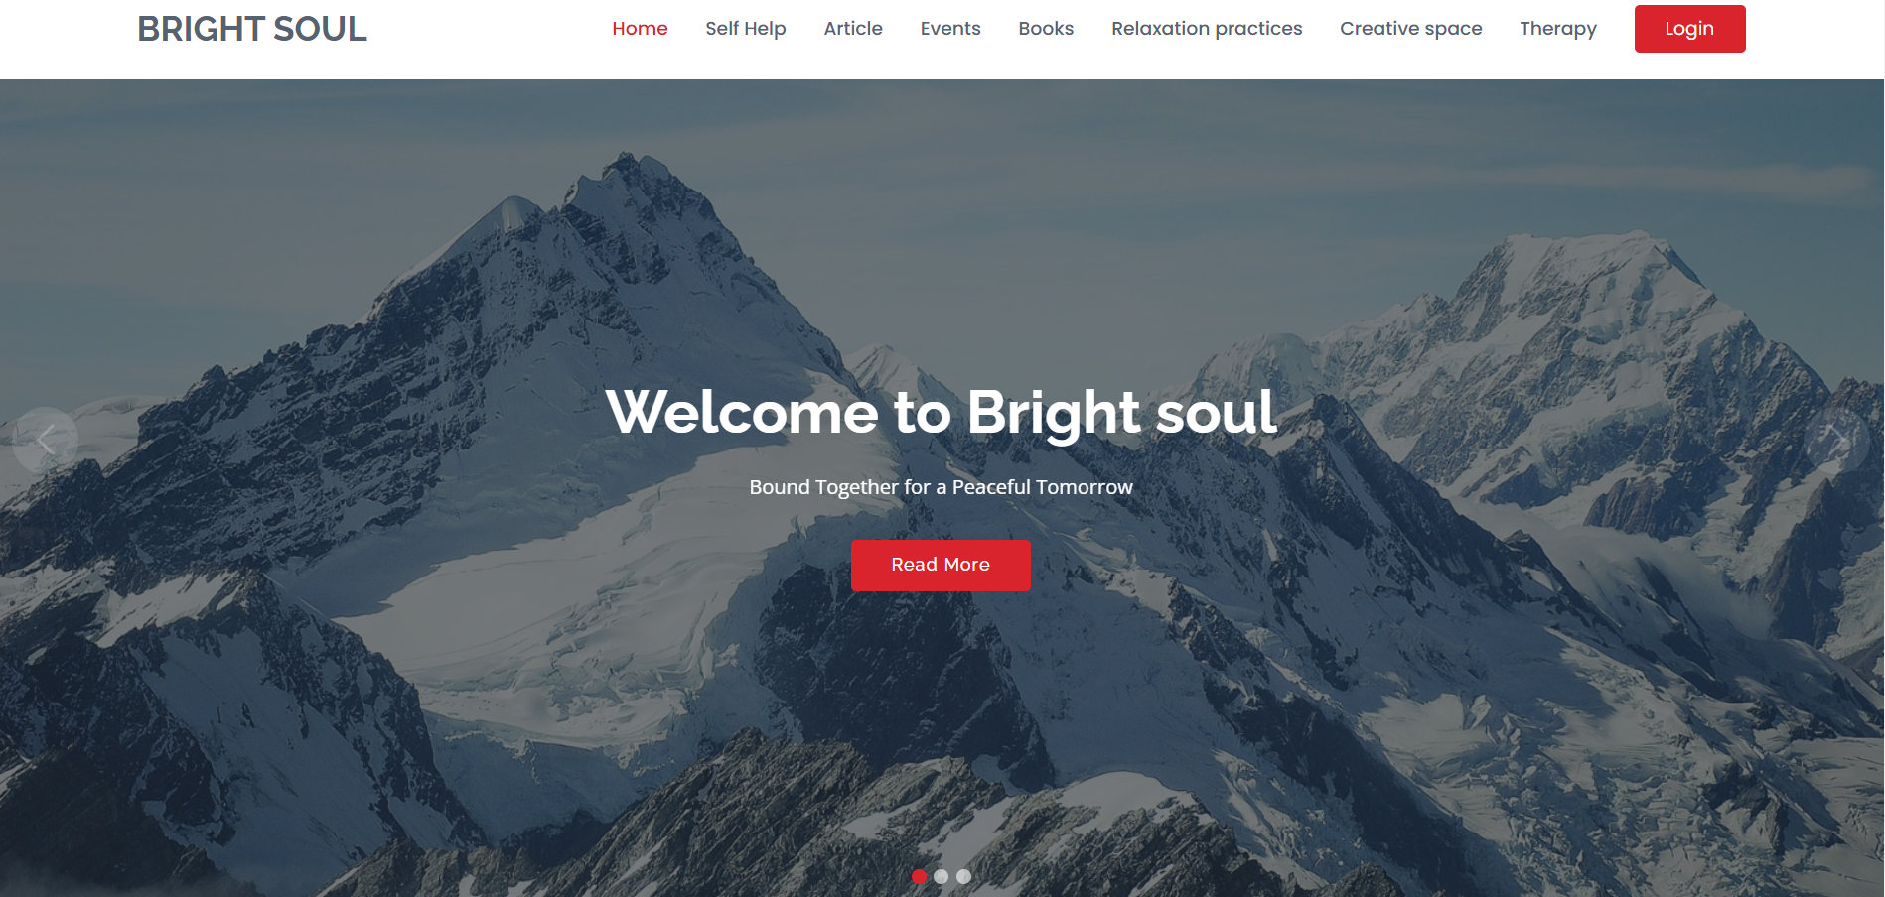

Demo homepage:

Slide 9
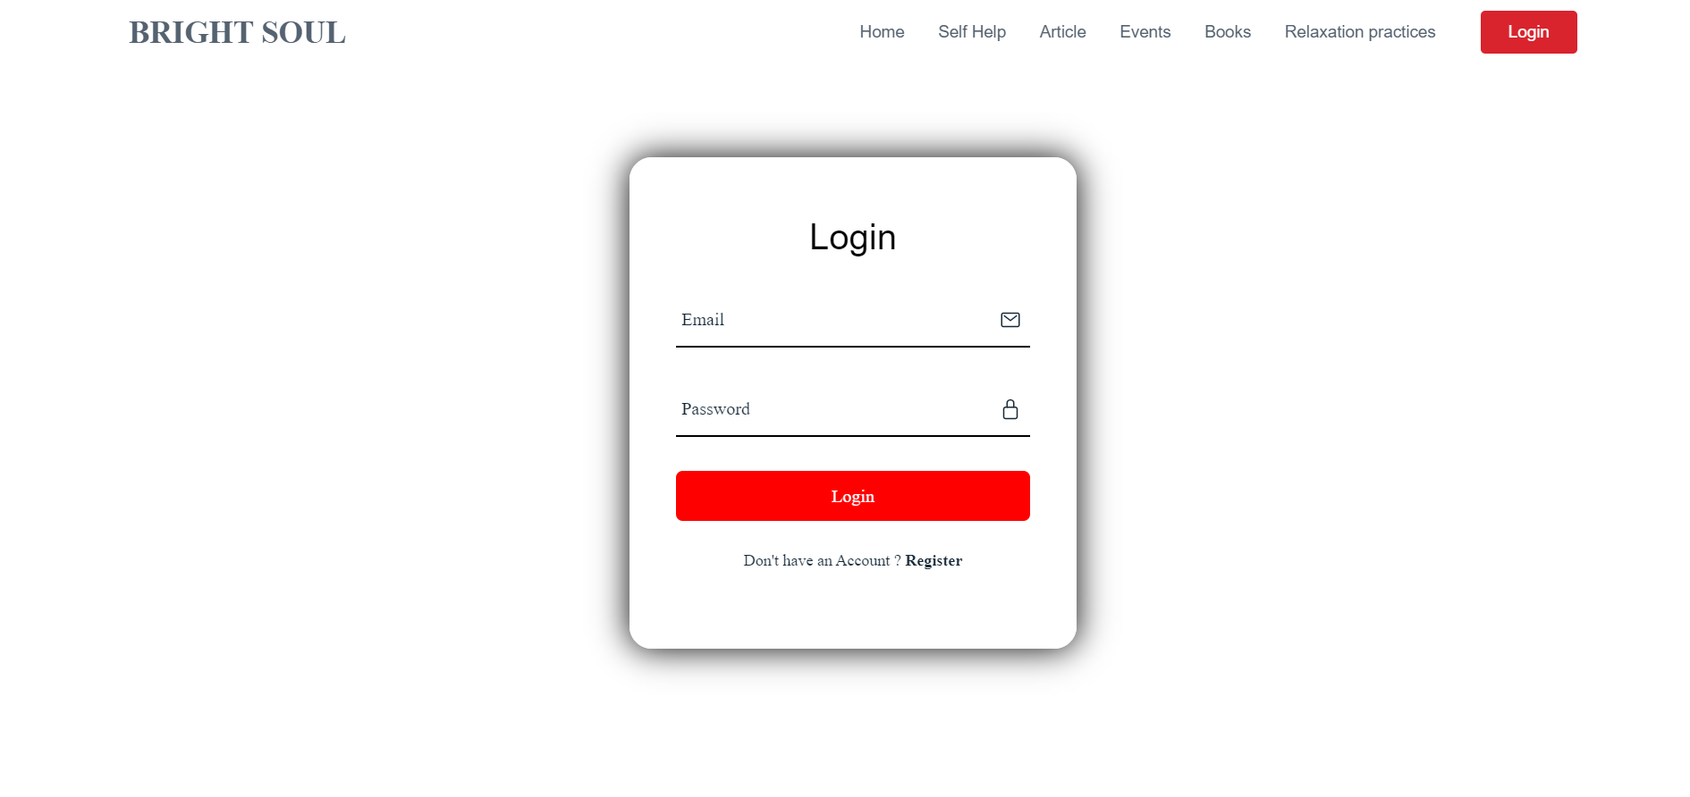

Demo Login page:

Slide 10
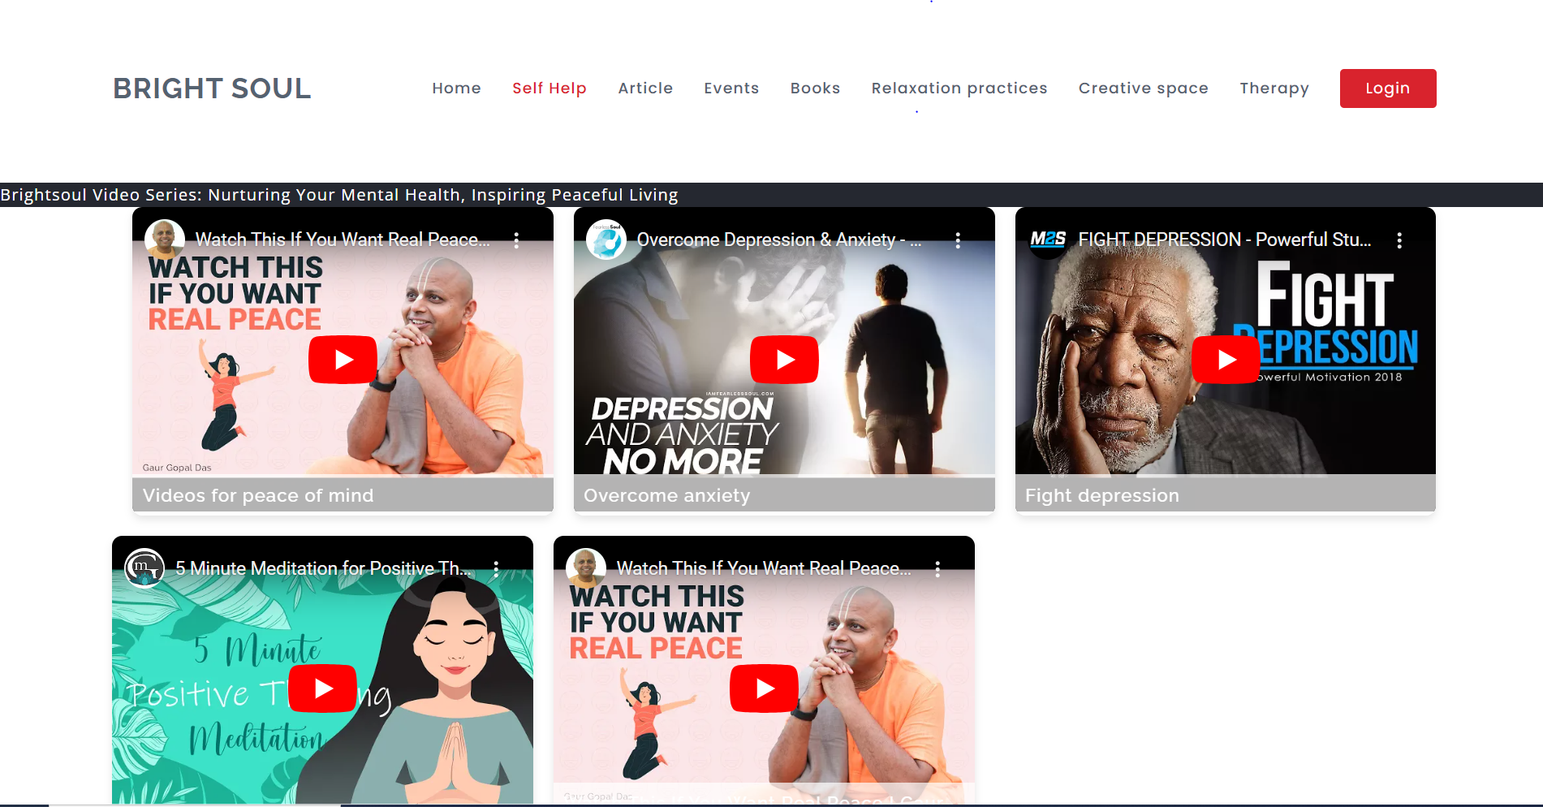

Demo self help page: video page:

Slide 11
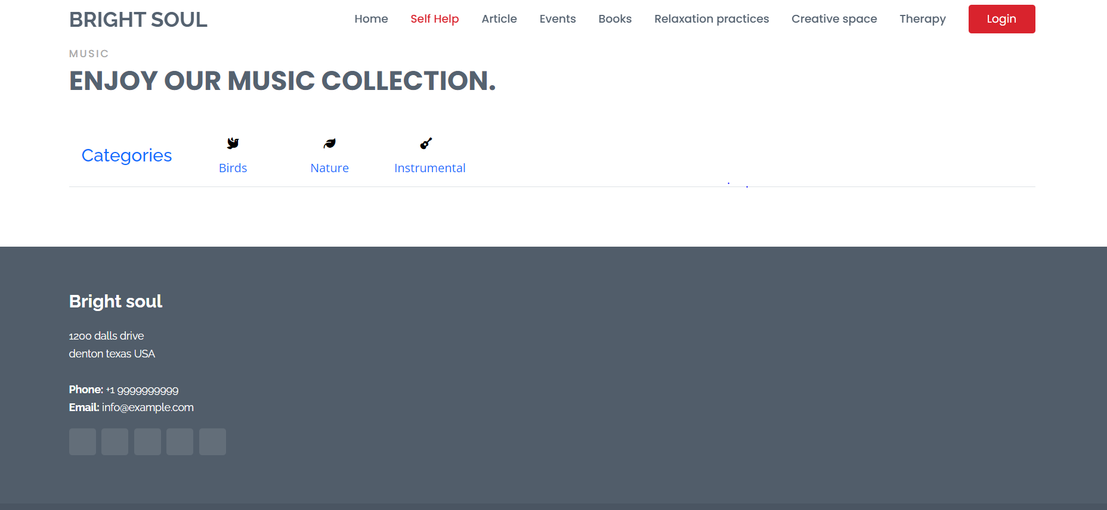

Demo music page:

Slide 12
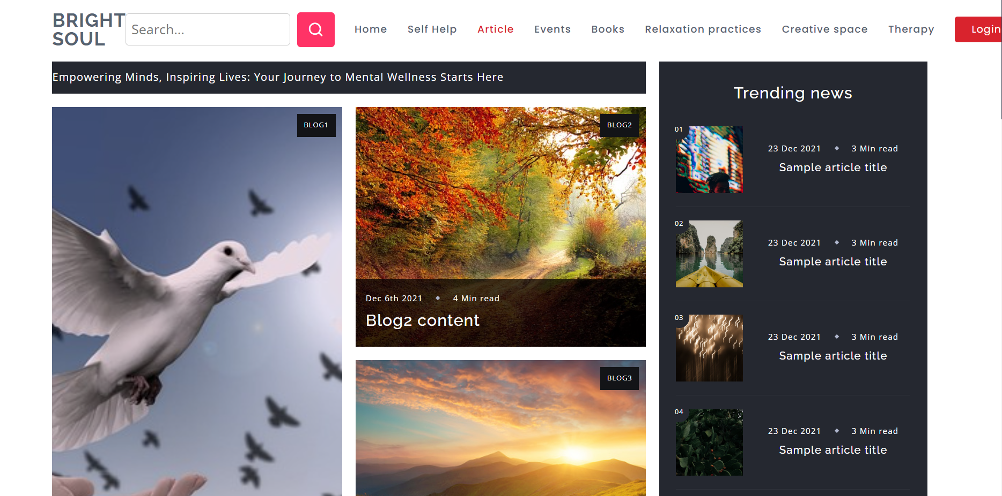

Demo articles page blogs page:

Slide 13
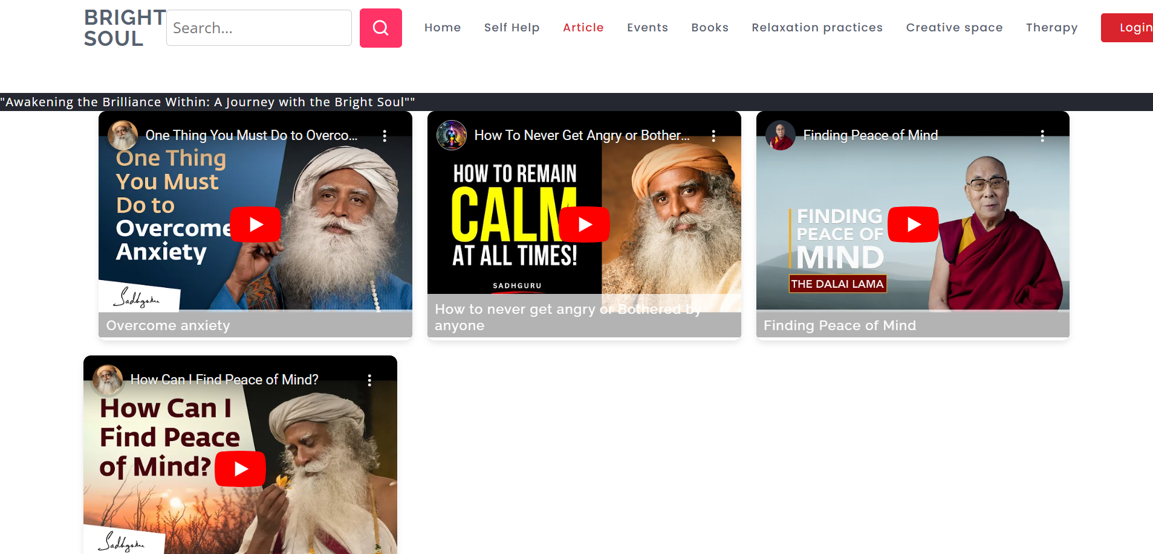

Demo video page:

Slide 14
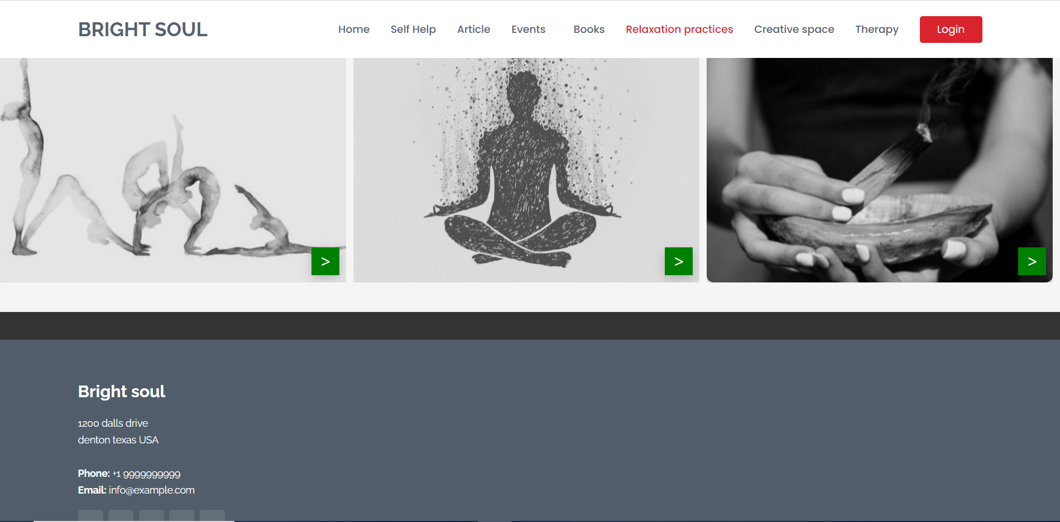

Demo Relaxation page:

Slide 15
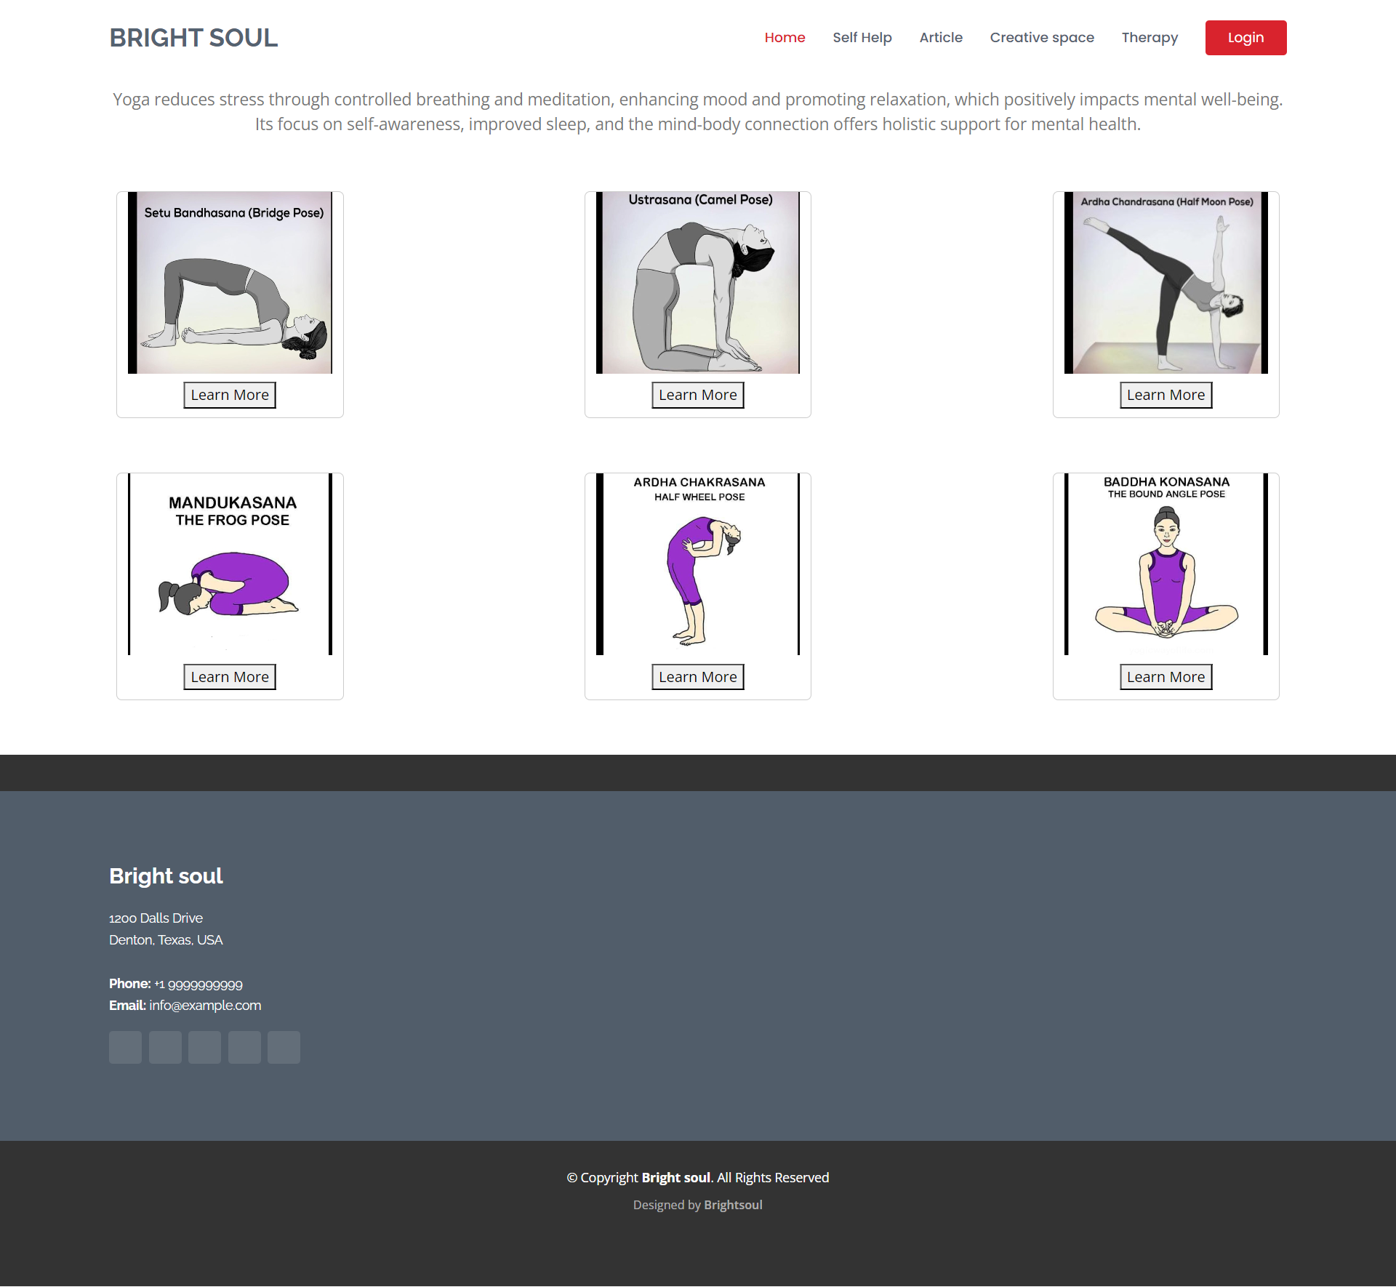

Demo yoga Technique page:

Slide 16
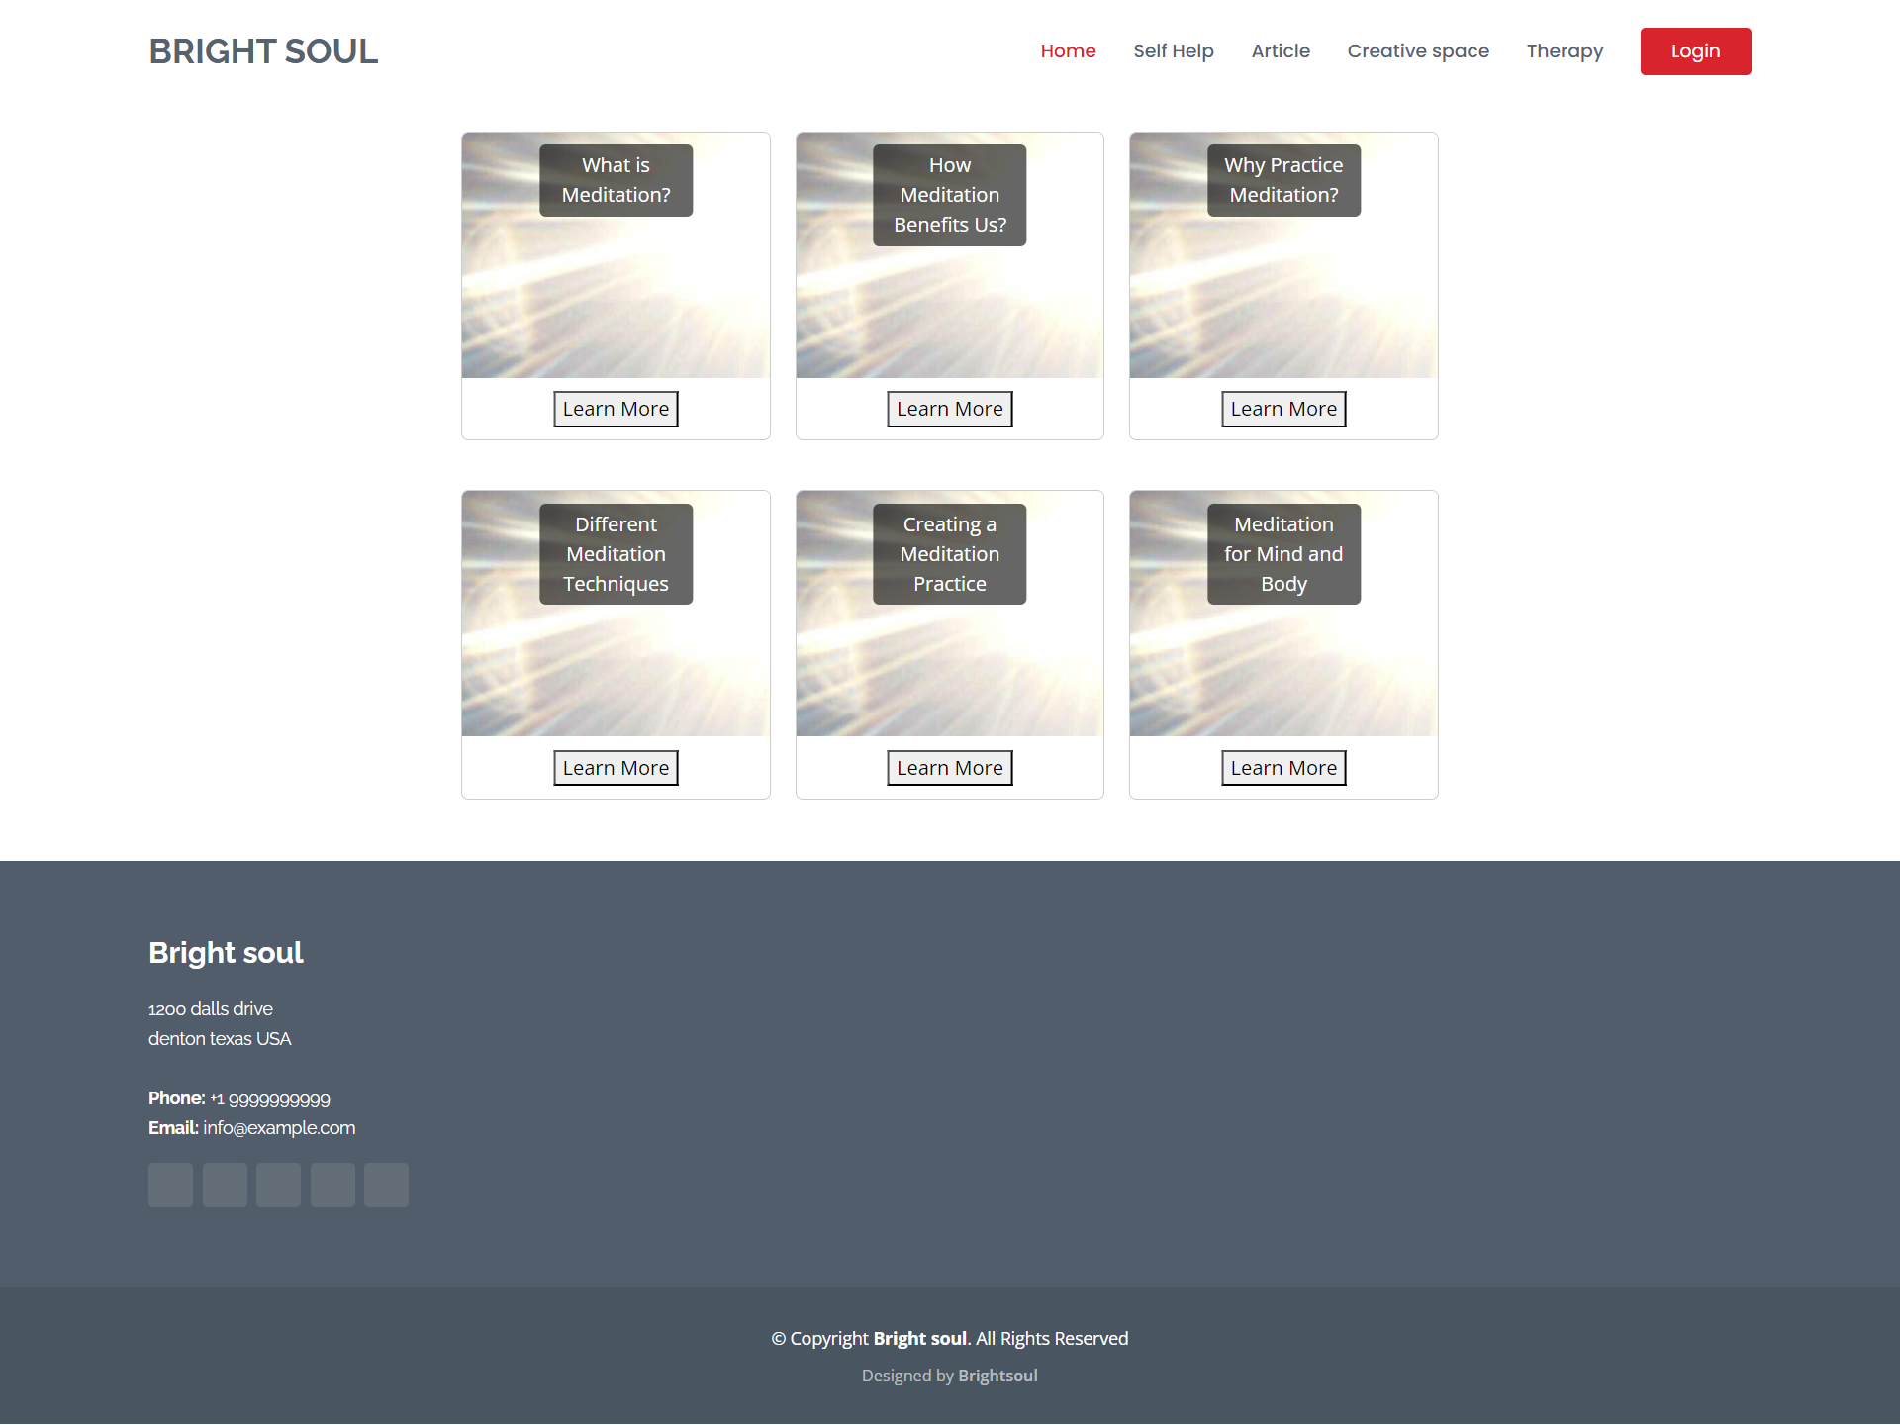

Demo meditation page:

Slide 17
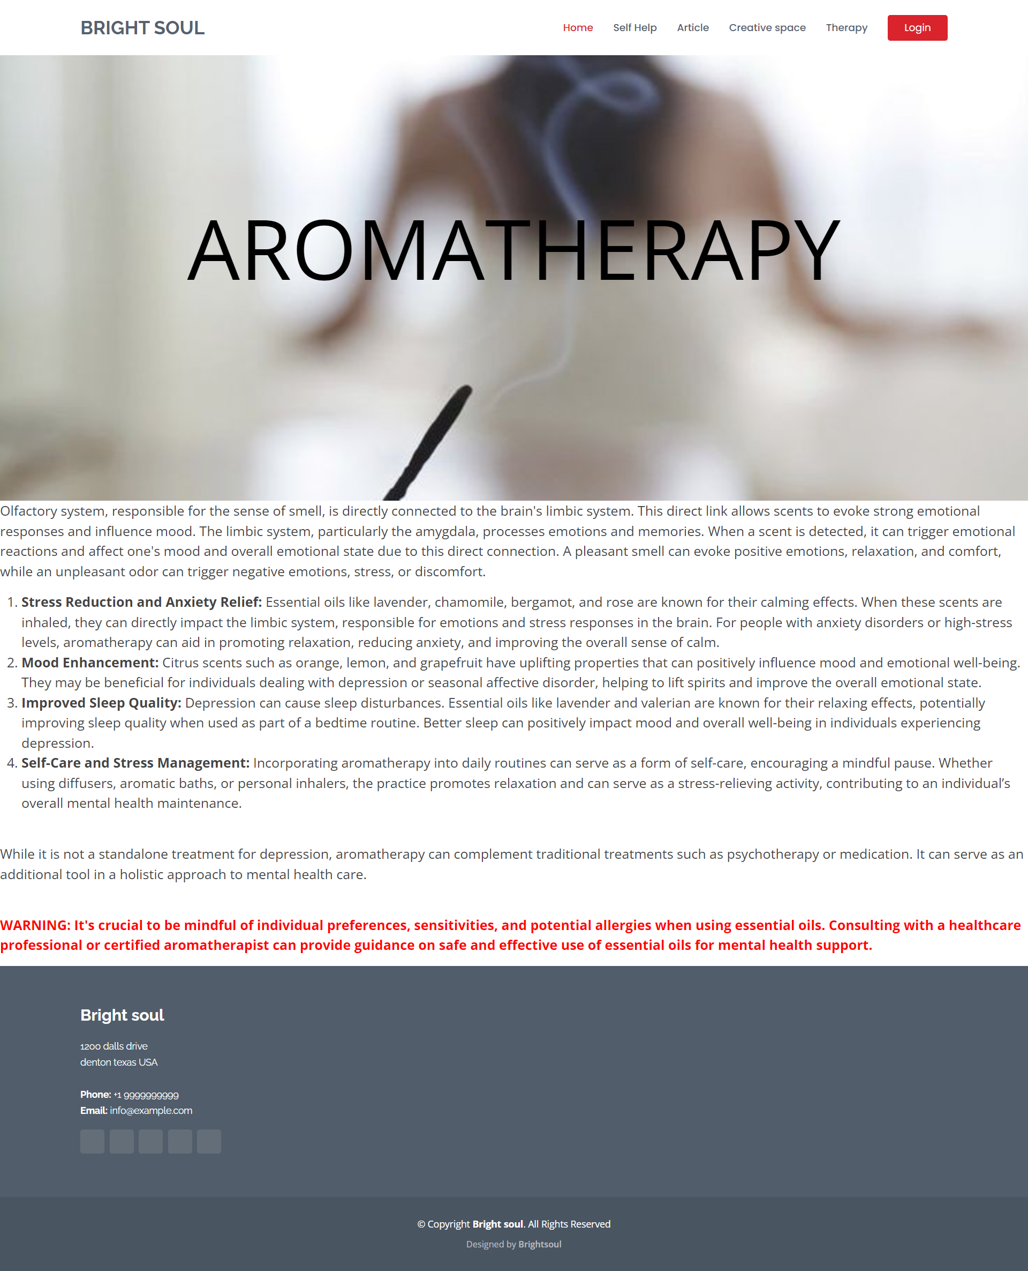

Demo Aromatherapy page:

Slide 18
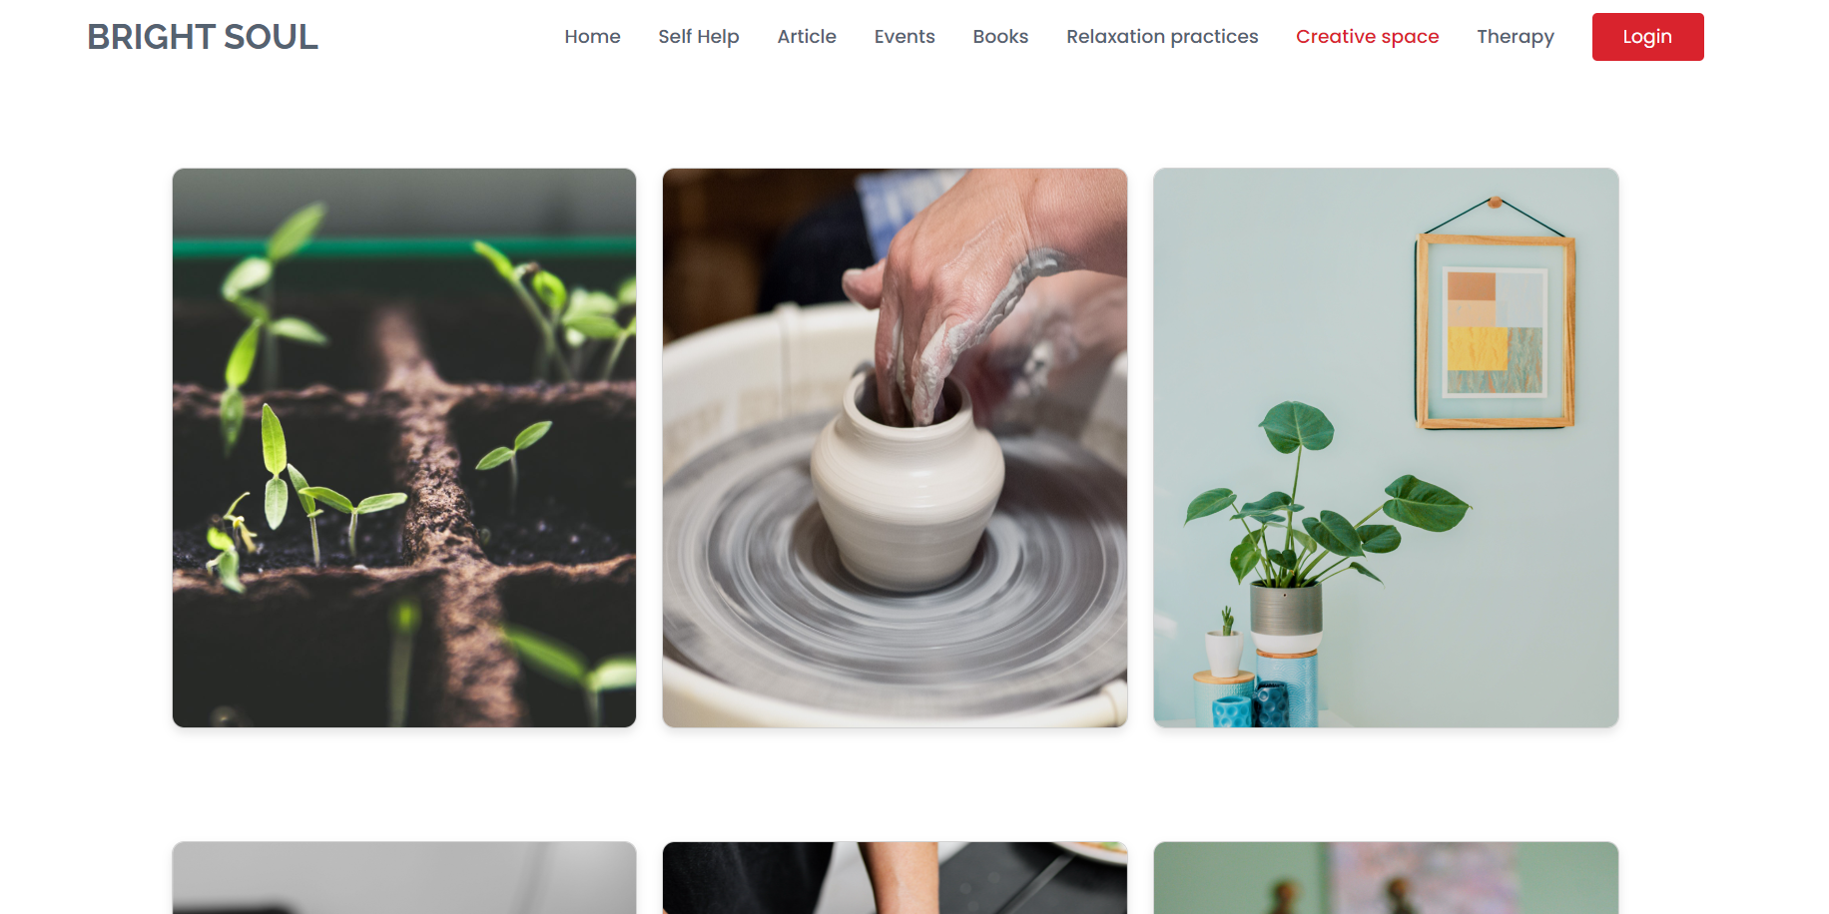

Demo creative space page:

Slide 19
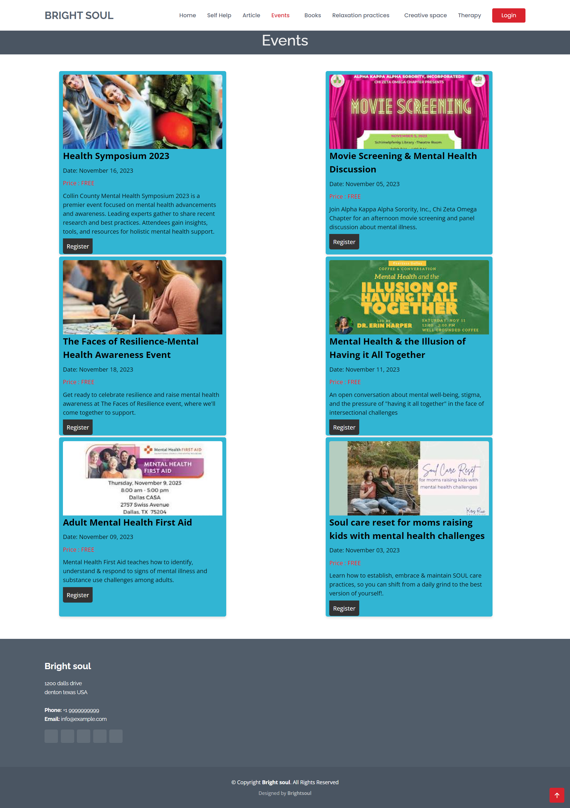

Demo events page:

Slide 20
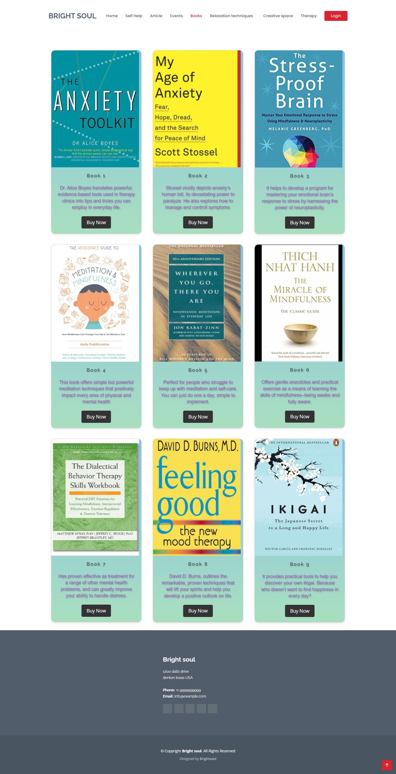

Demo books page:

Slide 21
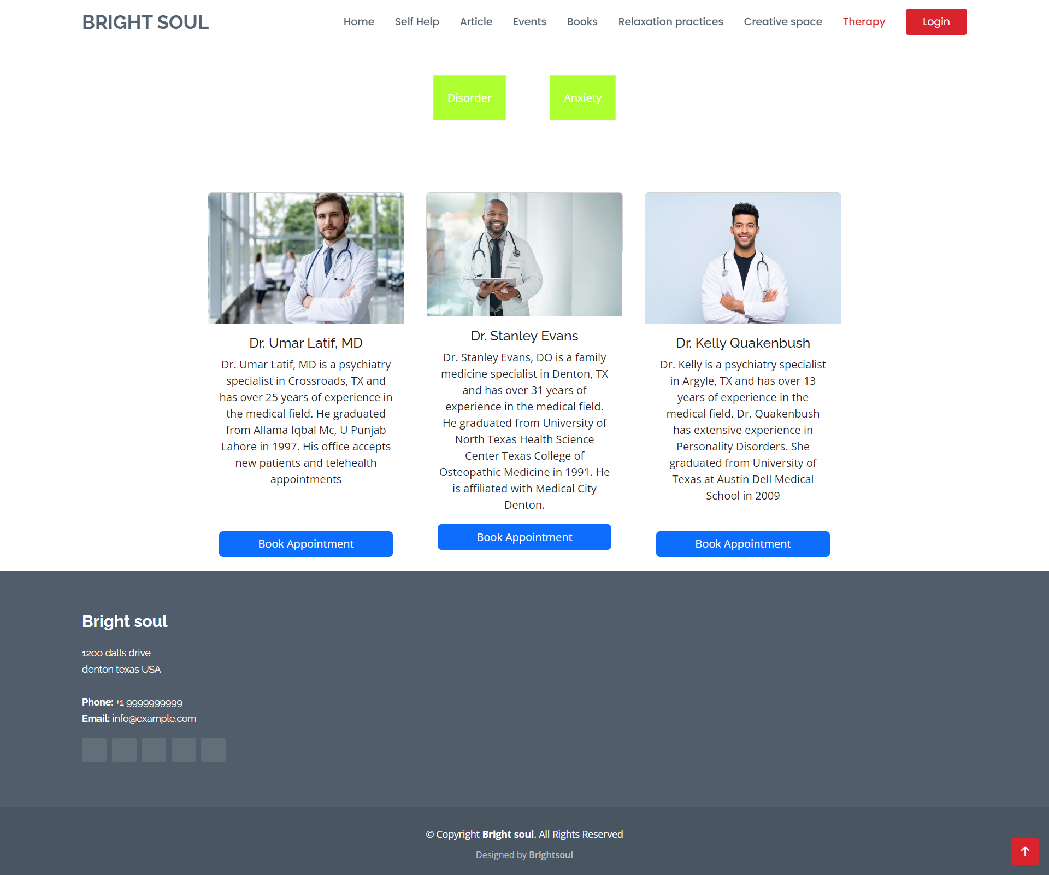

Demo therapy page:

Slide 22
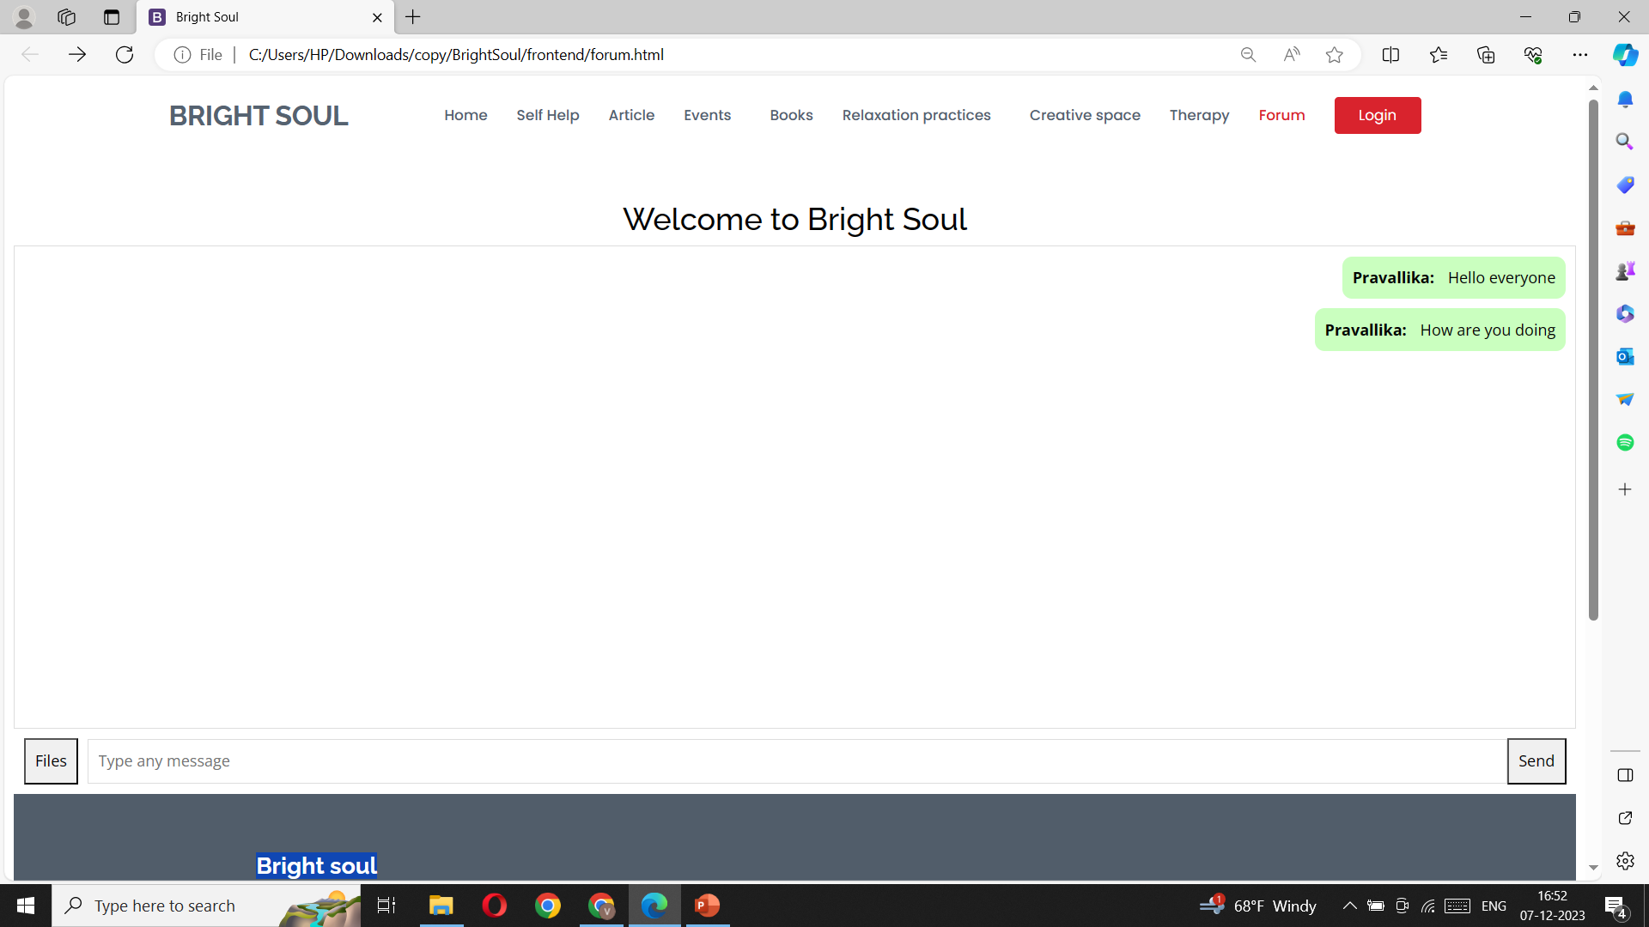

Demo forum page:

Slide 23

THANKYOU
FROM
BRIGHT SOUL TEAM

